Slide 1
React.js

Slide 2
Fundamentals of React

Slide 3
Get introduced to ES6
- ECMAScript Introduction
- Features of ES6
Get introduced to React
- React library introduction
- Fundamentals of React

Slide 4

By the end of this lesson, you will be able to:
Explain the working and advantages of React
Learn how to render UIs
Illustrate Components and their lifecycle
Build forms and Components
Implement interaction between Components and the React Router

Slide 5
Why React

Slide 6

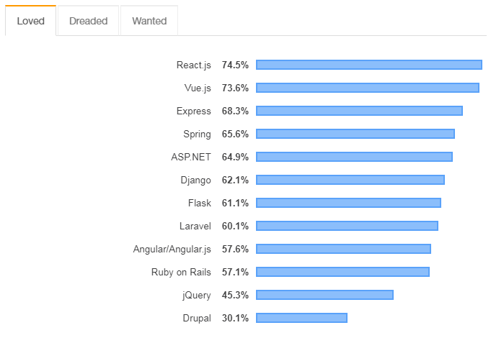
Why React
It is one of the most used JavaScript frameworks, developed by Facebook engineers.
It’s a highly sought-after skill in web development.
It is used extensively in Instagram, Netflix, PayPal, and Apple.
It can be used to build web applications, native mobile apps, command-line interfaces, or avionics.
It can also build any complex UI keeping state out of the DOM.
It is easy to learn and use.
Source: Stackoverflow Developer Survey Results 2019
Notes:
In the short span of time, since React JS was open-sourced, it has been one of the most used JavaScript frameworks by most web development companies to build interactive web apps because of its useful features and easy adaptability. This is why it has become one of the highly sought web skills in recent time.
According to the Stack Overflow developer survey 2019, React js is the most loved web framework. % in the graph indicates the proportion of developers who are developing with React and have expressed interest in continuing to develop with it.

Slide 7
Introduction to React

Slide 8
Introduction to React
A JavaScript library for building UI
Used to produce HTML that is shown to a user in a web browser
Current version is v16.8.6
Features of React:
Composition
Declarative code
Unidirectional data flow
Notes:
React shows a heavy use of composition i.e. combining simple functions to build complex functions.
It also features a declarative coding style, another reason for its simplicity and popularity.
A unidirectional data flow lets you keep track easily and reduces complexity.

Slide 9
Composition
React combines simple functions to build complex ones.
Simple functions follow the DOT(Do One Thing) rule.
React combines Components to make up its UI.
Components are key building blocks in React.

Slide 10
Components
Components are pieces of the UI.
<Page />
<Header />
<Article />
<Footer />
A complex Component can be created combining enough simple Components.
<Page>
<Header />
<Article />
<Footer />
</Page>
Notes:
React recommends use of Composition as everything in React is a Component, and it follows a strong Component based model. Hence, composition is a better approach here for code reuse.

Slide 11
Declarative Code
Declarative programming is a programming paradigm.
Imperative code tells JavaScript how it should perform each step.
Declarative code tells JavaScript what needs to be done.
Declarative programming makes code more readable.
It abstracts away a lot of implementation details, making the code easier to understand.

Slide 12
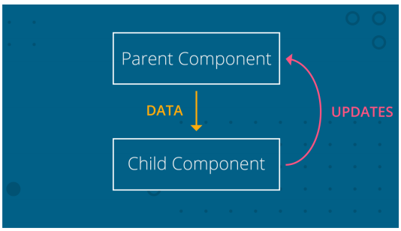
Unidirectional Data Flow
Data lives in the parent Component.
Data flows from parent Component to child Component as needed.
Updates to the data are sent to the parent Component.
The parent performs the actual change.

Slide 13
Building a React App

Slide 14
create-react-app Tool
The create-react-app tool creates a React app.
It’s a command-line tool that scaffolds a React app.
It helps to build React SPAs.
It sets up the development environment with latest JS features.
It optimizes the app for production.
It seamlessly integrates build tools like Babel and Webpack.
It works with zero configuration.
Notes:
You don’t need to install or configure tools like Webpack or Babel. They are preconfigured and hidden so that you can focus on the code.

Slide 15
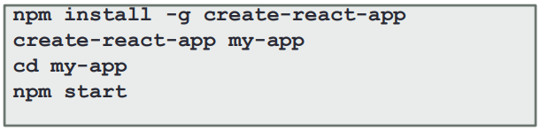
create-react-app Tool
The first command installs the create-react-app tool globally.
The keyword create-react-app followed by the app name will create the app in the current directory.
Navigate to the newly created app directory and run npm start to run the app.
Notes:
You might have to run sudo before npm install depending on how you set up node.

Slide 16
create-react-app Tool
Running the create-react-app command creates the following directory structure:
my-app
├── README.md
├── node_modules
├── package.json
├── .gitignore
├── public
│ ├── favicon.ico
│ ├── index.html
│ └── manifest.json
└── src
├── App.css
├── App.js
├── App.test.js
├── index.css
├── index.js
├── logo.svg
└── serviceWorker.js
Open http://localhost:3000/ to see your app

Slide 17
Creating a React App
Problem Statement: Create a blogger app using React.

Slide 18
Assisted Practice: Guidelines
Steps to create a blogger app using React:
Install the create-react-app tool if it’s not installed.
Create a React project in your terminal.
Explore the directory structure.
Run npm start to run the boilerplate web app.

Slide 19
Rendering UI

Slide 20
React Elements
The UI is built using React Elements.
React Elements are lightweight JavaScript objects.
They describe what the page should look like and let React do DOM manipulation.
We will first need to call React.createElement() to create an Element.
We can then use ReactDOM.render() to render an Element to a page.
Once an Element is created, we can add child Elements and nested child Elements.

Slide 21
React.createElement()
Syntax of createElement is React.createElement(<type>, <props>, <content>).
<type>:
If we're creating an HTML Element, we pass in the name as a string.
If we're creating a React Component, we pass in the variable that the Component is assigned to.
<props>:
It is an object of HTML attributes and has custom data about the Element.
It is either null or a JavaScript object.
<content>:
It represents the children of that Component.
It can be null, a string, a React Element, or a React Component.
React.createElement() returns one root Element.
Notes:
A common pattern to avoid typing React.createElement repeatedly, is to assign it to a constant.

Slide 22
ReactDOM.render()
Syntax of render is ReactDOM.render(<Element>, <container>)
<Element>: A React Element or Component we want to render
<container>: The DOM node we want to render into
Returns a reference to the Component or null for stateless Components
Updates if the React Element was previously rendered into the container
Executes the optional callback after the Component is rendered or updated if it is provided as an argument
Notes:
ReactDOM.render() controls the contents of the container node you pass in. Any existing DOM Elements inside are replaced when first called. Later calls use React’s DOM diffing algorithm for efficient updates.
ReactDOM.render() does not modify the container node, only the children of the container. It may be possible to insert a Component to an existing DOM node without overwriting the existing children.
ReactDOM.render() currently returns a reference to the root ReactComponent instance. However, using this return value is legacy and should be avoided because future versions of React may render Components asynchronously in some cases. If you need a reference to the root ReactComponent instance, the preferred solution is to attach a callback ref to the root Element.

Slide 23
Nested Elements
We can pass in a reference to another Component as the final argument to the createElement method.
This allows us to nest Elements and Components within each other.
We can nest as many child Components we want.
We don't need to store Elements in variables beforehand. They can be declared inline when needed.
The code below creates two li Elements within an ol Element.
const Element = React.createElement(‘ol’, null,
React.createElement(‘li’, null, ‘Brad’),
React.createElement(‘li’, null, ‘James’),
);

Slide 24
JSX

Slide 25
JSX
React believes in coupling rendering logic with other UI logic.
JSX is a syntax extension to JavaScript that lets you write JS code that looks like HTML.
It makes code concise and easy to understand.
React doesn’t require using JSX, but it’s helpful as a visual aid when working with UI inside the JavaScript code.
JSX also makes it easy to show useful error and warning messages.
It returns one root Element.
Notes:
Instead of artificially separating technologies by putting markup and logic in separate files, React separates concerns with loosely coupled units called “Components” that contain both.

Slide 26
JSX Examples
The code snippets below show how Jsx lets you write JavaScript that looks like HTML.
Example 1:
const Element = <ol>
<li>Brad</li>
<li>James</li>
</ol>;
Example 2:
const people = [
{ name: 'Brad' },
{ name: 'James' }
];
const Element = <ol>
{ people.map(person => (
<li key={person.name}>{person.name}</li>
))}
</ol>;

Slide 27
Components

Slide 28
Features of Components
Are key features of React
Encapsulate UI Elements, data, and behavior of a view
Allow you to break a complex web page into smaller, manageable, and reusable parts
Help us create our own custom Elements
Let us group Elements together and use them as one Element
Are defined as classes that extend React.Component
Require only the render() method
Return the HTML to be rendered onto the page
Notes:
we can say that every application you will develop in React will be made up of pieces called Components. You can see a UI broken down into multiple individual pieces called Components and work on them independently and merge them all in a parent Component which will be your final UI.Conceptually, Components are like JavaScript functions. They accept arbitrary inputs or props and return React Elements describing what should appear on the screen.

Slide 29
Benefits of Components
Make the code modular and reusable
Provide the ability to configure Components with different props
Let us independently configure Components
Create well-defined interfaces
Have clear responsibilities as they follow the Single Responsibility Principle

Slide 30
Components and Props
A prop is any input that you pass to a React Component.
A prop is added just like an HTML attribute; prop name and value are added to the Component.
Props are stored on the this.props object.
Props are read-only; a Component must never modify its own props.
In the code below, the name Brad is a prop.
// passing a prop to a Component
< Welcome name=‘Brad’ />
// access the prop inside the Component
...
render() {
return <h1> Hello, {this.props.name} </h1>
}
...
Notes:
When React sees an Element representing a user-defined Component, it passes JSX attributes to this Component as a single object. We call this object “props”. The name ‘Brad’ is a prop here.
Whether you declare a Component as a function or a class, it must never modify its own props.
Such functions are called “pure” because they do not attempt to change their inputs, and always return the same result for the same inputs.

Slide 31
Functional Components
A Functional Component is a React Component without render function. Functional Components:
Accept a single props object argument
Return UI description, that is, the React Element
Have no this keyword
Do not keep track of internal state
In the code below Email is a functional Component.
function Email(props) {
return <div>{props.text}</div>;
}
class Email extends React.Component {
render() {
return <div>{this.props.text}</div>;
}
}
Notes:
There have been various React Component Types in the past, but with the advent of React Hooks it’s possible to write the whole application with just functions as React Components.
Function Components are basically JavaScript Functions being React Components which return JSX.
If you want to render a React Component inside a Function Component, you define another Component and render it as an HTML Element with JSX within the other Component’s body.

Slide 32
Rendering Components
The following code renders a Component named Welcome.
function Welcome(props) {
return <h1>Hello, {props.name}</h1>;
}
const Element = <Welcome name=“Karen" />;
ReactDOM.render(
Element,
document.getElementById('root')
);

Slide 33
Composing Components
Components can refer to other Components in their output.
function Welcome(props) {
return <h1>Hello, {props.name}</h1>;
}
function App() {
return (
<div>
<Welcome name=“Steve" />
<Welcome name=“Brad" />
<Welcome name=“Karen" />
</div>
);
}
ReactDOM.render(
<App />,
document.getElementById('root')
);

Slide 34
Elements and Components
Problem Statement: Build UI for a blogger app.

Slide 35
Assisted Practice: Guidelines
Steps to add Elements and Components in the app:
Include Bootstrap in the app.
Create Components within the app including root, parent, and child Components.
Render the root Component using react-dom library.
Create function- and class-based Components.
Compose smaller Components together to form bigger and complex Components.
Reload the web page to see the changes.

Slide 36
State

Slide 37
Props and State
Props
Refer to attributes from parent Components
Represent read-only data that are immutable
State
Is a plain JavaScript object that is used to record and React to user events
Represents mutable data
Affects what is rendered on the page
Is managed internally by the Component
Is meant to change over time based on user input
Notes:
props are variables passed to it by its parent Component. State on the other hand is still variables, but directly initialized and managed by the Component.The state can be initialized by props.

Slide 38
Managing State
Every class-based Component has its own state object.
When a Component’s state is changed, it immediately rerenders and forces all of its children to rerender as well.
The code below shows a class-based Component named User.
class User extends React.Component {
state = {
username : ‘Steve'
}
render() {
return (
<div>Username: {this.state.username}</div>
);
}
}
ReactDOM.render(
<User />,
document.getElementById('root')
);

Slide 39
Setting State Using Props
Props can be used to set the internal state based on a prop value in the constructor.
Here, the Component class calls the base constructor with props as we want to access this.state in the constructor.
class User extends React.Component {
constructor(props) {
super(props);
this.state = {
username: 'Steve'
}
}
render() {
return (
<div>Username: {this.state.username}</div>
);
}
}
ReactDOM.render(
<User />,
document.getElementById('root')
);

Slide 40
Updating State
Components can update their state using the this.setState() method.
Whenever setState() is called, React rerenders the entire app and updates the UI.
The Component’s UI is a function of the Component state as indicated below.
UI = fn(state)

Slide 41
Updating State
There are two ways to use setState() as shown in the code snippets below.
this.setState({
subject: 'Hello! This is a new subject'
})
When a Component's new state depends on the previous state, we can use the functional setState().
this.setState((prevState) => ({
count: prevState.count + 1
}))
Notes:
Important things to keep in mind:
Do not modify the state directly
State Updates May Be Asynchronous
State Updates are Merged

Slide 42
PropTypes
Is a package that lets us define data type of props for a Component
Is installed using the command, npm install --save prop-types
Is used to make sure the data received is valid
Code below shows a class-based Component Greeting using PropTypes to validate if name is of type string
import PropTypes from 'prop-types';
class Greeting extends React.Component {
render() {
return (
<h1>Hello, {this.props.name}</h1>
);
}
}
Greeting.propTypes = {
name: PropTypes.string
};
Notes:
We can use the propType for validating any data we are receiving from props.

Slide 43
Component Lifecycle Events

Slide 44
Component Lifecycle Events
Four stages in a React Component’s life:
Initialization:
Component is constructed with the given Props and default state
Done in the constructor of a Component Class
Mounting:
The JSX returned by the render method is rendered
Updating:
The state of a Component is updated and the application is repainted
Unmounting:
The Component is removed from the page
Notes:
Every React Component has a lifecycle of its own, lifecycle of a Component can be defined as the series of methods that are invoked in different stages of the Component’s existence.

Slide 45
Component Lifecycle Methods
Component lifecycle methods are methods in a Component that get invoked at certain times during the Component’s lifecycle.
They are automatically bound to Component instance.
Component Lifecycle Methods:
ComponentWillMount()
Invoked immediately before the Component is inserted into the DOM
ComponentDidMount()
Invoked immediately after the Component is inserted into the DOM
ComponentWillUnmount()
Invoked immediately before a Component is removed from the DOM
ComponentWillReceiveProps()
Invoked when the Component is about to receive new props
Notes:
render() method should
• only be used for displaying the content
• not make any AJAX (HTTP) requests
• not alter the DOM
• We put the code that should handle things like AJAX
requests in lifecycle events

Slide 46
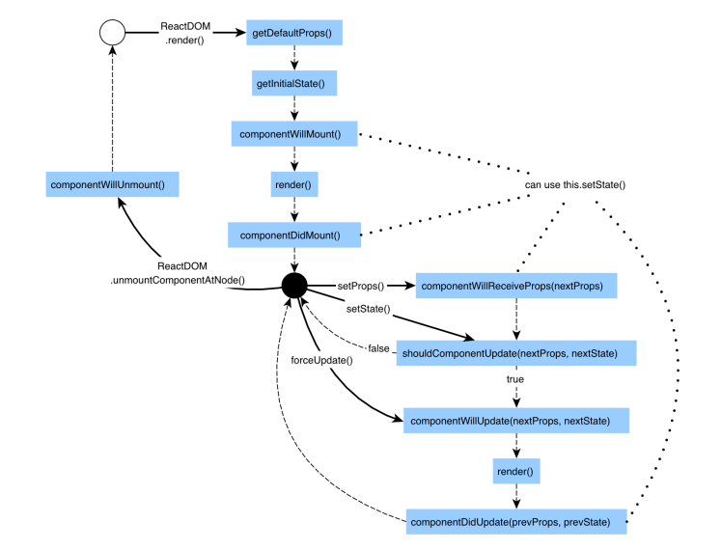
Component Lifecycle

Slide 47
React Events

Slide 48
Handling Events
React events are named using camelCase.
Examples: onClick, onChange, onSubmit
With JSX, you pass a function as the event handler, rather than a string.
The code below shows the events onChange and onSubmit being handled.
<form onSubmit={this.handleSubmit}>
...
</form>
<input type="text" className="form-control"
id="productName" name="name" value={product.name}
onChange={this.handleChange} />

Slide 49
Handling Events
To prevent default behavior, explicitly call the preventDefault() function.
The code below shows preventDefault() being called.
<form onSubmit={this.handleSubmit}>
...
</form>
handleSubmit(event) {
event.preventDefault();
// Continue with form submission logic
}
Notes:
Here, ‘event’ is a SyntheticEvent instance i.e., a cross-browser wrapper around the browser’s native event

Slide 50
Handling Events
An event handler is a method on the Component class.
In JavaScript, class methods are not bound by default.
If you refer to a method without () after it, you should bind that method in the constructor.
In the code below, handleSubmit is bound in the constructor and can be invoked without parenthesis.
class ProductForm extends Component {
constructor(props) {
super(props);
this.handleSubmit = this.handleSubmit.bind(this);
}
render() {
return(
…
<form onSubmit={this.handleSubmit}>
…
);
}
}

Slide 51
Handling Events
You can also use an arrow function in the callback.
In the code below onSubmit is implemented as an arrow function.
class ProductForm extends Component {
constructor(props) {
super(props);
}
handleSubmit(e) { ... }
render() {
return(
…
<form onSubmit={e => this.handleSubmit(e)}>
…
);
}
}
Notes:
Binding in the constructor is generally recommended as arrow function method has a performance problem

Slide 52
React Events
Problem Statement: Demonstrate how to handle the events in the blogger app.

Slide 53
Assisted Practice: Guidelines
Steps to demonstrate handling events:
Identify the components that can change states.
Implement onChange, onClick and onSubmit methods.
Reload the web page to see the changes.

Slide 54
Conditional Rendering

Slide 55
Conditional Rendering
Works the same way conditions do in JavaScript
Creates multiple Components and renders them based on some conditions
Uses JavaScript operators like if or the conditional(ternary) operator
Code below changes the text being rendered based on an if condition
function UserGreeting(props) { ... }
function GuestGreeting(props) { ... }
function Greeting(props) {
const isLoggedIn = props.isLoggedIn;
if (isLoggedIn) {
return <UserGreeting />;
}
return <GuestGreeting />;
}
Notes:
Consider the situation of handling a login/logout button. If a user is logged in then we will have to render the Logout Component to display the logout button and if the user is not logged in then we will have to render the Login Component to display the login button. This is Conditional Rendering.

Slide 56
Conditional Rendering
You can also use variables to store Elements. In the code below, the Element LogoutButton is saved in the variable button.
render() {
const isLoggedIn = this.state.isLoggedIn;
let button = null;
if (isLoggedIn) {
button = <LogoutButton onClick={this.handleLogoutClick} />;
} else {
button = <LoginButton onClick={this.handleLoginClick} />;
}
return (
<div>
<Greeting isLoggedIn={isLoggedIn} />
{button}
</div>
);
}

Slide 57
Conditional Rendering
You can embed expressions in JSX by wrapping them in curly braces as shown below.
function Mailbox(props) {
const unreadMessages = props.unreadMessages;
return (
<div>
<h1>Hello!</h1>
{ unreadMessages.length > 0 &&
<h2>
You have {unreadMessages.length} unread messages.
</h2>
}
</div>
);
}

Slide 58
Conditional Rendering
The JavaScript conditional operator can also be used to conditionally render Elements or Components as shown below.
render() {
const isLoggedIn = this.state.isLoggedIn;
return (
<div>
{isLoggedIn ? (
<LogoutButton onClick={this.handleLogoutClick} />
) : (
<LoginButton onClick={this.handleLoginClick} />
)}
</div>
);
}

Slide 59
Handling Lists

Slide 60
Lists
Lists are mainly used for displaying menus on a website.
They are a major improvement over traditional JavaScript which uses arrays to make lists.
The code below shows a Component accepting an array of numbers and outputting an unordered list of Elements using map().
function NumberList(props) {
const numbers = props.numbers;
const listItems = numbers.map((number) =>
<li>{number}</li>
);
return (
<ul>{listItems}</ul>
);
}

Slide 61
Keys
They are special string attributes to be included when creating lists of Elements in React.
They are used to uniquely identify a list item among its siblings.
They help React identify which items have changed, are added, or are removed.
They should be given to the Elements inside the array to give them a stable identity.
The code below shows how to create a list of to-dos with ids and texts per to-do.
const todoItems = todos.map((todo) =>
<li key={todo.id}>
{todo.text}
</li>
);
Notes:
Keys are used to give an identity to the Elements in the lists. It is recommended to use a string as a key that uniquely identifies the items in the list. Using indexes for keys can negatively impact performance and may cause issues with Component state

Slide 62
Embedding map() in JSX
JSX allows embedding expressions in curly braces in order to inline the result of map() as shown below.
const ProductList = ({ products }) => {
return (
<div>
<div className="list-group">
{ products.map(product => (
<Link
key={product.id}
to={`/products/${product.id}`}
className="list-group-item"
>
{ product.name}
</Link>
))}
</div>
</div>
);
};

Slide 63
Lists
Problem Statement: Demonstrate how to add a list of blog categories in the blogger app.

Slide 64
Assisted Practice: Guidelines
Steps to to demonstrate lists:
Setup a json-server for api calls.
Create a new file for handling categories.
Include code to access the server using Fetch API.
Reload the web page to test the changes.

Slide 65
Forms

Slide 66
Forms
HTML form Elements work differently from other DOM Elements in React.
Form Elements naturally keep some internal state.
The form below shows the default HTML form behavior, that is, browsing to a new page when the user submits the form.
<form>
<label>
Name:
<input type="text" name="name" />
</label>
<input type="submit" value="Submit" />
</form>
This works in React, but it’s recommended to use a JavaScript function.
This function would handle the submission of the form and has access to the data that the user entered in the form.
This is achieved using a technique called Controlled Components.

Slide 67
Controlled Components
Form Elements in HTML maintain their own state and update it based on user input
In React, mutable state is kept in the state property of Components and only updated with setState()
We combine the two by making the React state be the single source of truth
Thus, the React Component that renders a form controls what happens in the form on user input
An input form Element whose value is thus controlled is a controlled Component
It allows us to dynamically update the UI based on Component’s state
The benefits include:
Instantly validating input
Conditionally disabling or enabling buttons
Enforcing input formats
Notes:
• Refer to Components that render a form, but the “source of truth” for that form state lives inside of the Component state rather than inside of the DOM
• An input form Element whose value is controlled by Component’s state
• The value attribute of form Element is set by state
• Its value only ever changes when the state changes

Slide 68
Controlled Components
Problem Statement: Demonstrate how to add a new post form in the blogger app.

Slide 69
Assisted Practice: Guidelines
Steps to demonstrate controlled Components:
Refactor the code to create smaller components that follow single responsibility principle.
Add a form for posts in the blogger app.
Define lifecycle methods for the post Components.

Slide 70
Component Interaction

Slide 71
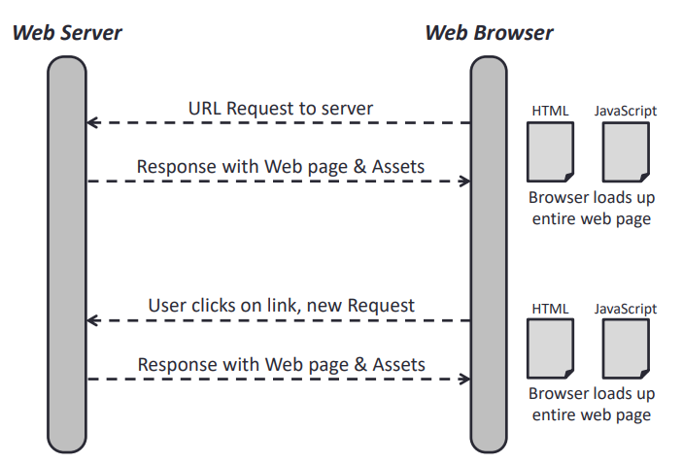
Traditional Web Apps
Request and Response in a traditional web app:

Slide 72
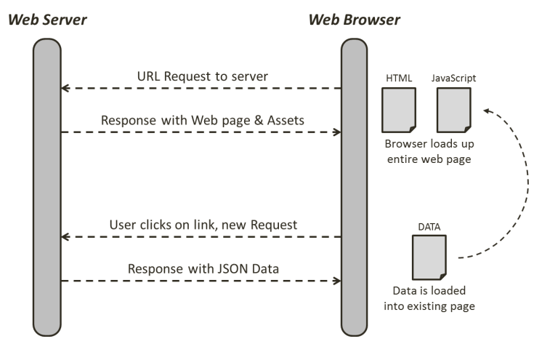
Single-Page App
Request and Response in a Single-Page App (SPA):

Slide 73
React Router

Slide 74
React Router
Turns React projects into SPAs which are a collection of navigational Components that compose declaratively with your application
Provides a number of specialized Components that:
Manage the creation of links
Manage the app’s URL
Provide transitions when navigating between different URL locations
Install React Router by running the command npm install --save react-router-dom
React Router has these Components :
BrowserRouter
Link
NavLink
Route
Switch

Slide 75
BrowserRouter
Below are the features of BrowserRouter:
It is used to handle dynamic requests.
It listens to changes in URL.
It makes sure that the correct screen, that is, the Component shows up.
It wraps your whole app in a BrowserRouter Component for the React Router to work.
The code below shows wrapping the app in BrowserRouter.
ReactDOM.render((
<BrowserRouter>
<App/>
</BrowserRouter>
), el)

Slide 76
Link
Below are the features of Link:
It provides declarative and accessible navigation around your application.
It is used instead of anchor tags (<a></a>).
The code snippet below demonstrates using Link.
< Link to = "/about" > About < /Link >

Slide 77
NavLink
NavLink is a special version of the <Link> that will add styling attributes to the rendered Element when it matches the current URL.
The code below shows implementing a NavLink.
<NavLink to = "/faq" activeClassName = “active“ >FAQs< /NavLink >
Notes:
In contrast, every <Route> that matches the location renders inclusively

Slide 78
Route
Route renders some UI when a location matches the route’s path
It can be implemented as shown below:
<Route exact path="/" Component={Home}/>
<Route path="/news" Component={NewsFeed}/>
<Route path="/home" render={() =>
<div>Home</div>
}/>

Slide 79
Switch
It renders the first child which could be either <Route> or <Redirect> that matches the location.
It is unique in that it renders a route exclusively.
The code below shows how to implement a Switch.
<Switch>
<Route path="/products/new" Component={ProductForm} />
<Route exact path="/products/:id"
Component={ProductDetail} />
<Route exact path="/products/:id/edit"
Component={ProductForm} />
<Route render={() => (
<AppAlert type="info"
message="Select a product from the list." />
)} />
</Switch>
Notes:
In contrast, every <Route> that matches the location renders inclusively

Slide 80
React Router
Problem Statement: Demonstrate how to add navigation functionality in the blogger app.

Slide 81
Assisted Practice: Guidelines
Steps to demonstrate how to use React Router:
Add React Router to the package.json file.
Create a home page to provide a navigation menu.
Add basic navigation Components to the blogger app.
Use React Router Components to implement navigation.
Reload the web page to see the changes.
Test the navigation.

Slide 83
Which of the following is a programming paradigm followed in React?
1
Imperative programming
Procedural programming
Object-oriented programming
Declarative programming

Slide 84
Which of the following is a programming paradigm followed in React?
1
Imperative programming
Procedural programming
Object-oriented programming
Declarative programming
d
React js follows the declarative style of code.

Slide 85
Which of the following statements is true about the ReactDOM?
2
ReactDOM is a package that provides DOM specific methods to enable an efficient way of managing DOM Elements.
We use ReactDOM to define and create our Elements.
The term ReactDOM refers to the HTML DOM.
ReactDOM is part of the React library.

Slide 86
Which of the following statements is true about the ReactDOM?
2
ReactDOM is a package that provides DOM specific methods to enable an efficient way of managing DOM Elements.
We use ReactDOM to define and create our Elements.
The term ReactDOM refers to the HTML DOM.
ReactDOM is part of the React library.
a
ReactDOM provides developers with an API which has DOM-specific methods that can be used at the top level of a web app to enable an efficient way of managing DOM Elements of the web page.
Notes:
We use React to define and create our Elements.
Prior to v0.14, all ReactDOM functionality was part of React. But later, React and ReactDOM were split into two different libraries.

Slide 87
Which of the following is a difference between props and state?
3
State is a variable whereas props are constants.
The state can be initialized by props but not vice-versa.
Props can be initialized by the state but not vice-versa.
Props are directly defined by a Component whereas the state is passed in by its parent Component.

Slide 88
Which of the following is a difference between props and state?
3
State is a variable whereas props are constants.
The state can be initialized by props but not vice-versa.
Props can be initialized by the state but not vice-versa.
Props are directly defined by a Component whereas the state is passed in by its parent Component.
b
Props can be used to set the internal state based on a prop value in the constructor.
Notes:
In a React Component, props are variables passed to it by its parent Component. State on the other hand is still variables, but directly initialized and managed by the Component.

Slide 89
React is declarative.
Each web page is built by combining small Components.
For every DOM object in React, there’s a corresponding virtual DOM object.
React lets you write apps for web as well as mobile.
React Router lets you navigate in a composable way.

